Slide 1
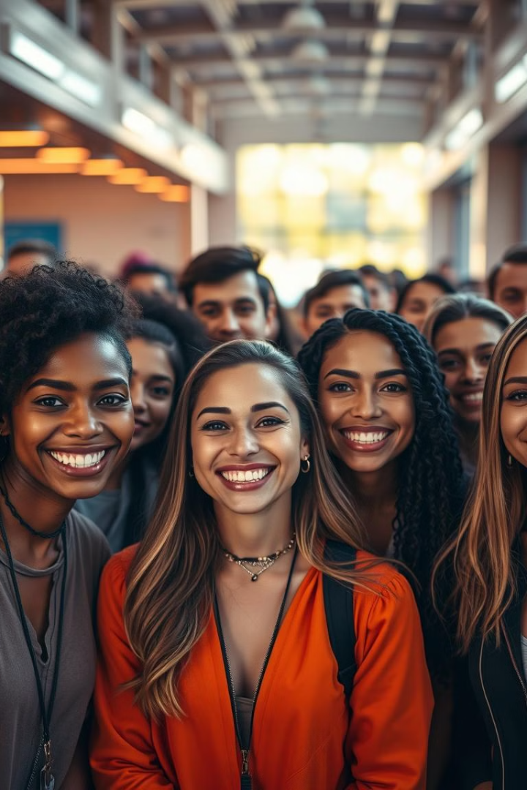
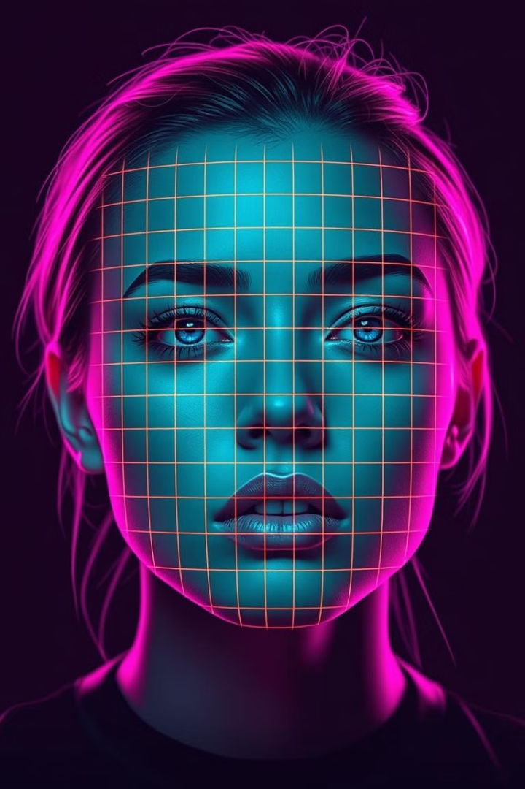
Face Recognition with FaceNet & SVM
This presentation details the development of a face recognition system using OpenCV, MTCNN, FaceNet, and SVM, deployed on Google Colab.

Slide 2
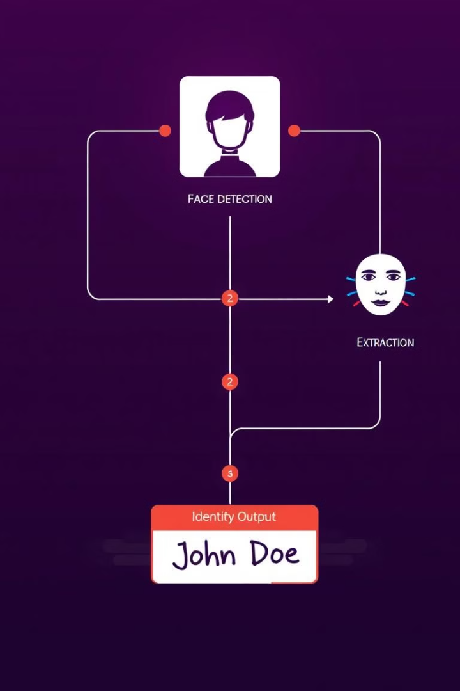
Project Overview & Objectives
Objective
Develop a face recognition system using deep learning embeddings for classification.
Dataset Handling
Extract and preprocess images for training.
Face Detection
Detect faces using MTCNN and resize them.
Model Training
Train an SVM classifier, predict identity.

Slide 3

Solution Approach & Implementation
Dataset Extraction
Extract from Google Drive ZIP.
2
Face Detection
Detect faces using MTCNN.
Image Resizing
3
Resize to 160x160.
4
Feature Extraction
Convert to 512D embeddings.
SVM Training
5
Train an SVM classifier with linear kernel.
6
Testing & Recognition
Load test image, predict identity.

Slide 4
Challenges & Future Improvements
Challenges
Overfitting
1
Dataset limited
Variability
2
Lighting, poses
Detection
3
False positives
Future Improvements
Expand dataset
Experiment with CNN
Deploy as real-world application

Slide 5
Key Takeaways
FaceNet + SVM
MTCNN
Achieves accurate face recognition by combining FaceNet and SVM.
MTCNN improves the accuracy of face detection in images.
512D Embeddings
SVM Performance
512D embeddings effectively represent unique facial features.
SVM performs well on small datasets, quick to train.

Slide 6
Project Links
1
Google Colab Notebook
2
Dataset Location
3
GitHub Repository
Access the project code and execute the face recognition process.
Download the dataset used for training the face recognition model.
Explore the complete source code, documentation, and resources.
Link to Notebook
Link to Dataset
Link to Repository

